Slide 1

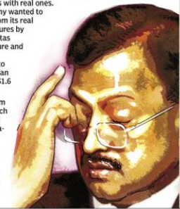
SATYAM FRAUD CASE
Name: Akshay Paul
Stream: MBA (Finance)
Roll. No: 2320982515

Slide 2
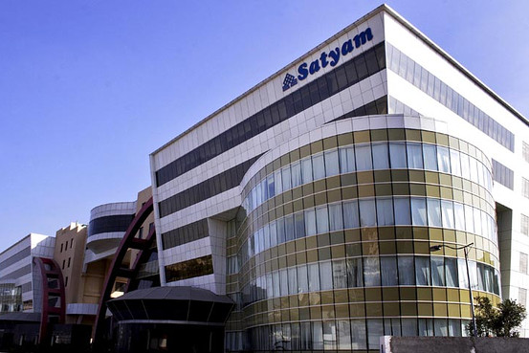
ABOUT
Satyam Computer Services Ltd (“Satyam”) was India’s fourth-largest computer services company.
Satyam was listed on the New York Stock Exchange (“NYSE”) in 2001.
It boasted many clients, including many Fortune 500 companies.

Slide 3

Introduction
The founder of Satyam Computer Services, B. Ramalinga 'Raju' (“'Raju'”), was a highly regarded entrepreneur.
In 2007, he was honoured with the Young Entrepreneur of the Year award.
Yet, mere two years later, On 7 January 2009, Mr B. Ramalinga 'Raju', chairman of Satyam, admitted in a Press Conference in Hyderabad to a ‘Rs.78 000 million’ fraud weeks after a bid to acquire the two Maytas firms failed.
“COOKING BOOKS OF ACCOUNTS”

Slide 4

Established on: June 24, 1987
Global Headquarters: Hyderabad, India
4

Slide 5

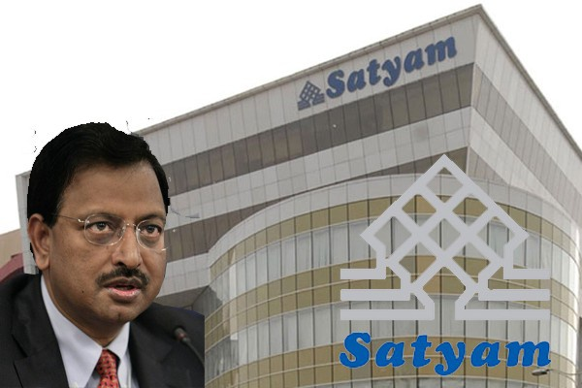
Yearly recap
Satyam was one of the youngest IT service companies to reach US $1 billion in annual revenues.
2008
Revenue crosses US $2-billion mark.
Adopts new tagline “Business Transformation. Together.”
Enters into a definitive agreement to acquire Chicago-based Bridge Strategy Group.

Slide 6
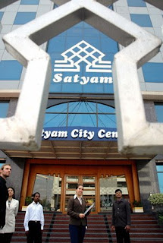
2007
Becomes the Official IT Services Provider for the FIFA World Cups, 2010 (South Africa) and 2014 (Brazil).
Announces acquisition of UK-based Nitor Global Solutions Limited.
Opens Global Development Center (GDC) in Malaysia.
Opens Development Center in Vizag, India.
2006
Revenue exceeds US$1 billion.
Sets up the first "Global Innovation Hub" in Singapore.

Slide 7
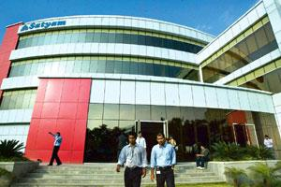
2005
FLC framework launched across the entire organization.
Largest global development center outside India (in Melbourne) begins operation.
Citisoft and Knowledge Dynamics acquired.
2002
Satyam BPO launched in Hyderabad.
First Customer Summit conducted.
2001
Satyam becomes world's first ISO 9001:2000 company to be certified by BVQI.
APAC headquarters established in Singapore

Slide 8
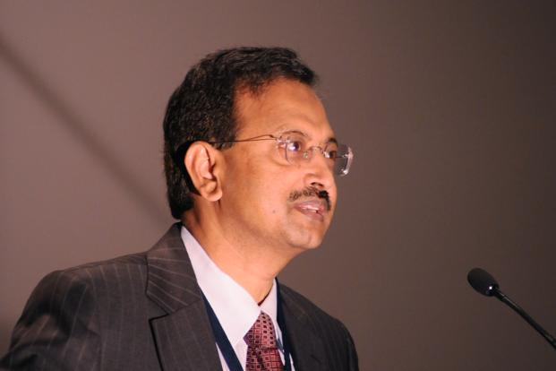
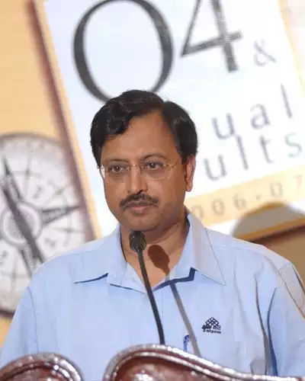
2000
Associate count reaches 10,000.
Satyam receives National HRD Award from Indian government.
1999
Satyam Infoway (Sify) becomes the first Indian Internet company listed on NASDAQ.
Satyam forms joint venture with TRW Inc.
Presence established in 30 countries.
1993
Awarded ISO 9001 Certification.
Satyam Technology Centre (STC) inaugurated.
Joint venture with GE announced.

Slide 9
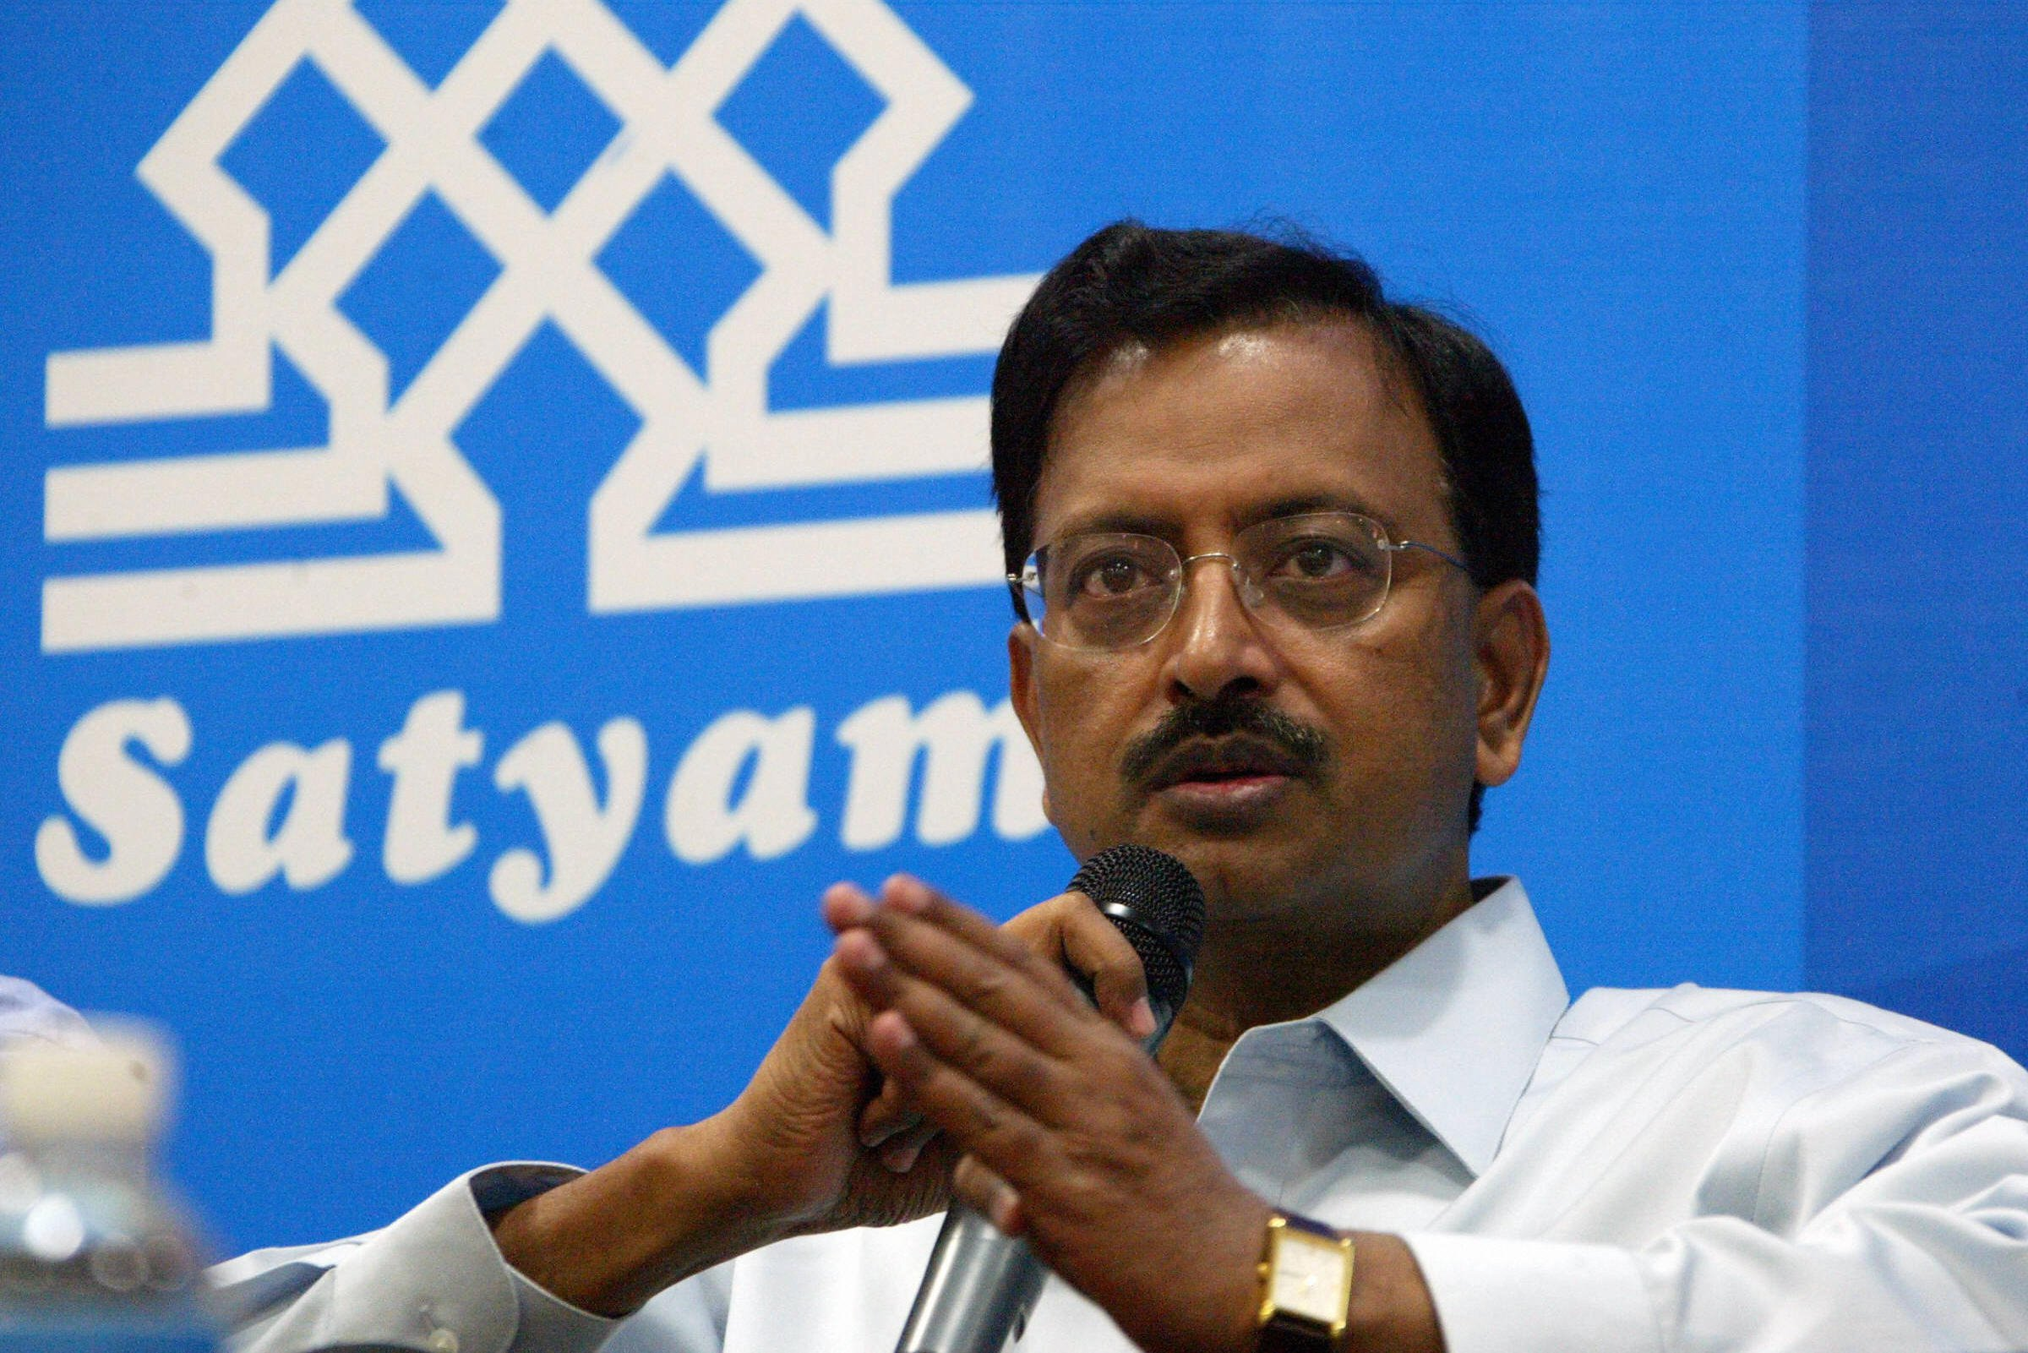
Rise of ‘'Raju'’
'Raju' was born on 16 September 1954 in the West Godavari district.
After completing his education, he returned to India in 1977 and opened a spinning mill, and soon after that began working in the real estate and infrastructure sectors.
'Raju' identified IT as an up-coming sunrise sector, and on 27 June 1987, with the help of brother-in-law, he founded Satyam Computer Services.
Accordingly, 'Raju' migrated to Andhra Pradesh’s capital city, Hyderabad. The company began with only 20 employees but quickly became a major player in the Indian IT sector, specialising in software outsourcing services.

Slide 10
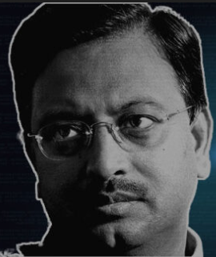

In 1991, Satyam debuted on the Bombay Stock Exchange (“BSE”). Its initial public offering (“IPO”) was oversubscribed 17 times.
'Raju' built close relationships with Indian politicians and business leaders. In 2000, he was invited to share the podium with US President Bill Clinton during his visit to Hyderabad.
Satyam had a global presence in 37 countries, and 'Raju' was an established star. His company was the fourth-largest IT company in India, just after Tata Consultancy Services (“TCS”), Infosys and Wipro.

Slide 11


'Raju' with MAYTAS
In 1988, 'Raju' and his family founded a group of companies called Maytas (“Satyam” spelt backwards). The Maytas group included Maytas Properties and Maytas Infrastructure Limited.
His sons, Tejas Raju and Rama Raju Jr headed the Maytas group.
Using 'Raju' influential political connections, Maytas Infrastructure acquired Indian government projects.

Slide 12
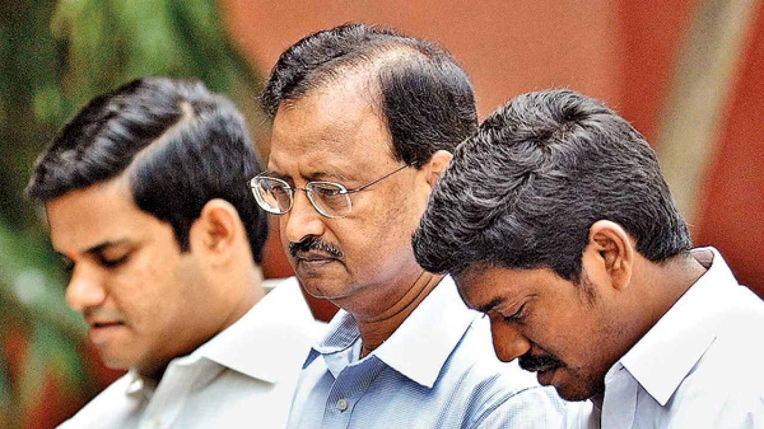
'Raju' tried to cover up the deceit in Satyam’s balance sheets by taking over Maytas. The cash transfer was to be used as a smokescreen to set the financial books right.
Shareholders strongly criticised the Maytas acquisition deal. It was seen as a move that would benefit the promoter family because the three firms (Satyam, Maytas Infrastructure and Maytas Properties) were promoted either by 'Raju' or his family members.
On 19 December 2008, the registrar of Indian companies ordered a probe into Satyam’s Maytas acquisition deal. This move was to investigate whether the Maytas acquisition deal was in violation of corporate governance norms or a diversification strategy.

Slide 13
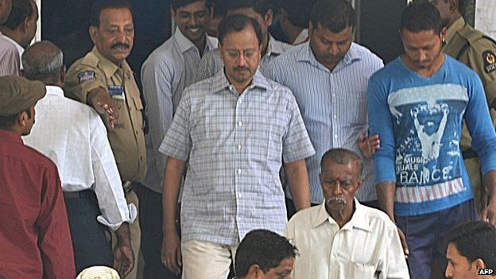
Key Players in the case
B. Ramalinga 'Raju'.
His brother in law.
Satyam's former managing director; former PwC auditor Subramani Gopalakrishnan.
T Srinivas; former chief financial officer.
Raju's other brothers

Slide 14
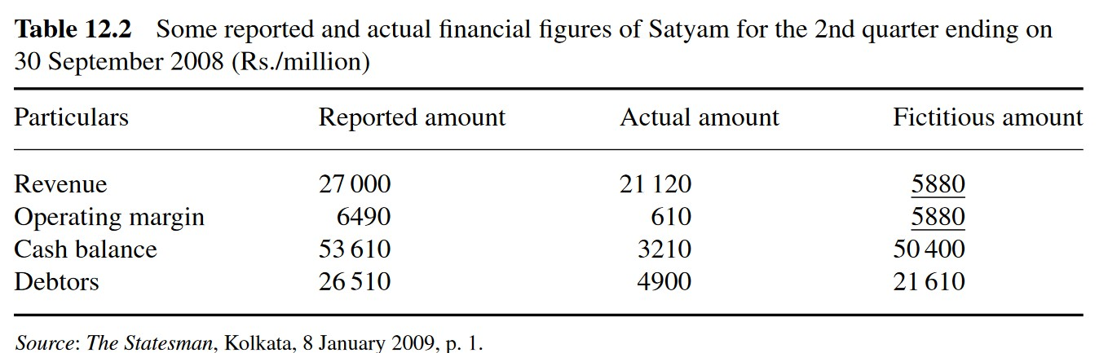



Fraudulent accounting practices
14

Slide 15
Fraudulent accounting practices
Cash and bank balance was overstated by Rs. 5,040 crore. The company had less than Rs. 300 crore cash and bank balances.”
The actual revenues were Rs. 2,112 crores, with an operating margin of Rs. 61 crores (or 3%). So, Satyam had made a profit of Rs. 61 crores but declared a profit of Rs. 649 crores. The difference was Rs. 588 crores.
The operating profit for the quarter was added to the cash and bank balances on the balance sheet. Hence, cash and bank balances increased by an artificial Rs. 588 crores for the three months ending Sept. 30, 2008. This was a formula that 'Raju' had been using for a while
To boost revenues, 'Raju' created fictitious clients (to boot sales revenue) with whom Satyam had entered into business deals. 'Raju' introduced 7,000 fake invoices to record the fake sales into the company's computer system. Since the clients were fictitious, they could not make real cash payments.

Slide 16
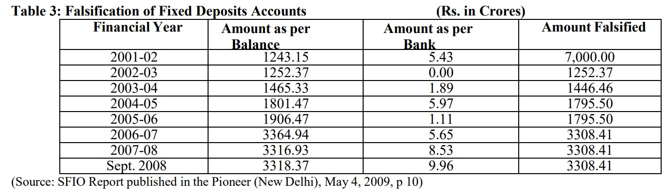
Fraudulent accounting practices
Further, once fake sales had been recorded, fake profits were also made and reported in accounts. Ultimately, the fake profits brought in fake cash, which needed to be invested somewhere. This led 'Raju' to create fake bank statements (showing forged fixed deposit receipts), where all the fake (or non-existed) cash the company was throwing up was being invested.

Slide 17
Fraudulent accounting practices
Finally, 'Raju' tried his best to use this fake cash to buy out two real-estate companies, Maytas Properties and Maytas Infra (both promoted by the family members), for a total value of $1.6 billion. The idea was to introduce some real assets in company accounts against all the fake cash the company had accumulated.
Further, Bhasin (2016) said, “The Satyam accounting scam, which involved unethical and illegal CA tactics, was to Rs. 8,000 crores. Shockingly, the scam had caused an estimated notional loss of Rs. 14,000 crore to investors”.

Slide 18


Fraudulent accounting practices
Showing Fake and Underutilized Employees :
One of the biggest sources of defalcation at Satyam was the inflation of the number of employees. 'Raju' claimed that the company had 53,000 employees on its payroll. But according to investigators, the real number was around 43,000. The fictitious/ghost number of employees could be fabricated because payment to the remaining 10,000 employees was faked year after year.

Slide 19
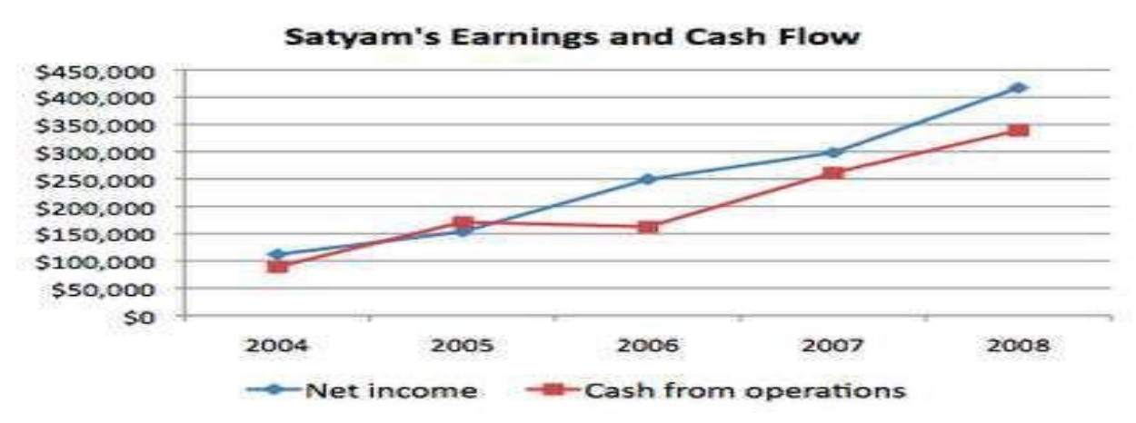
Fraudulent accounting practices
companies that misreport income often show a much stronger trend in earnings than they do in cash flow from operations.
There is not much of a real difference between Satyam’s net income trends and its cash flow from operations during 2004 and 2005. That is not because the earnings were genuine but because the cash flows were manipulated too. To do that, 'Raju' had to forge several large accounts receivables (ARs) and falsify their cash collections simultaneously.
If cash flow from a company's operating activities is consistently less than the reported net income, it is a warning sign. The investor must ask why operating earnings are not turning into cash.

Slide 20
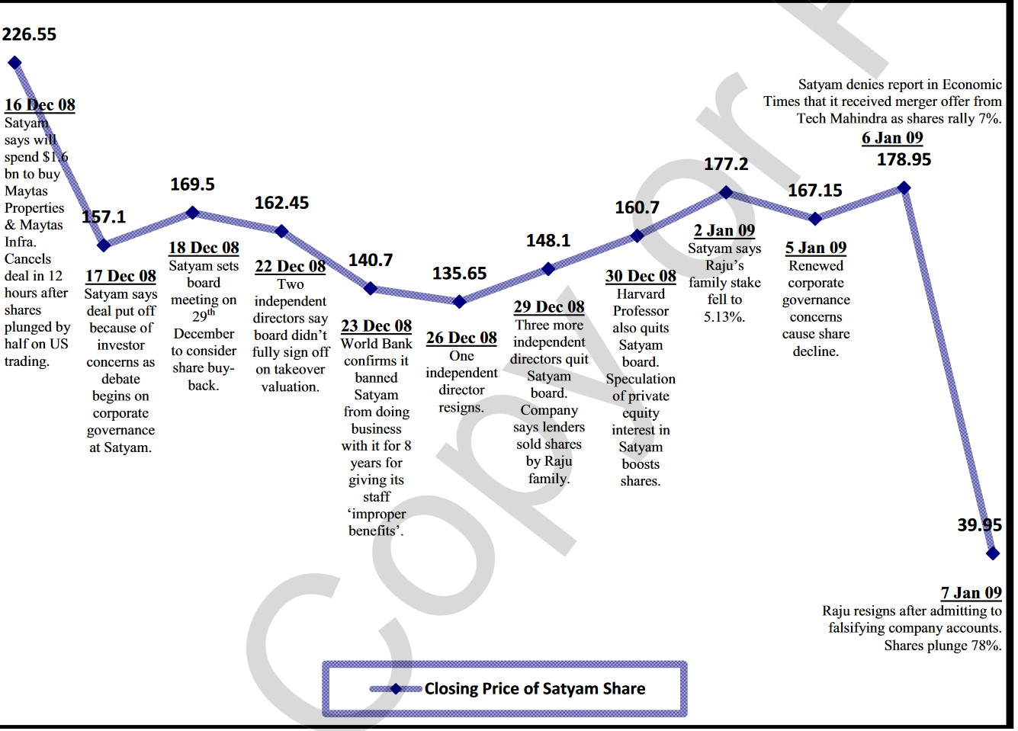

Slide 21
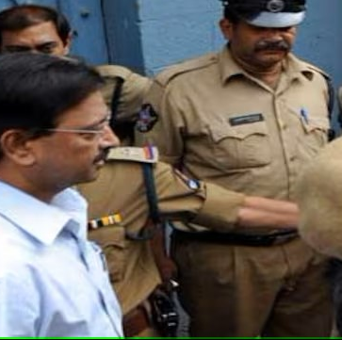
whistleblower
The Satyam scam was exposed by an anonymous whistleblower who sent emails to one of the company’s directors, Krishna Palepu, revealing the fraud. Krishna forwarded the emails to another director and S. Gopalakrishnan, a partner at PwC, the auditor of Satyam. The emails were sent from the alias Joseph Abraham. The whistleblower also alerted the SEBI and the media about the scam. The emails prompted an investigation by the regulators and the auditors, eventually leading to Raju’s confession and arrest.

Slide 22
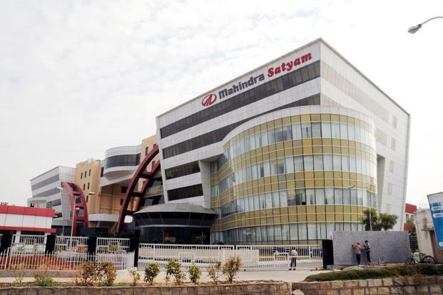

Slide 23


Thank you
Akshay paul
Mba-finance
2320982515

